Slide 1











1

Slide 2
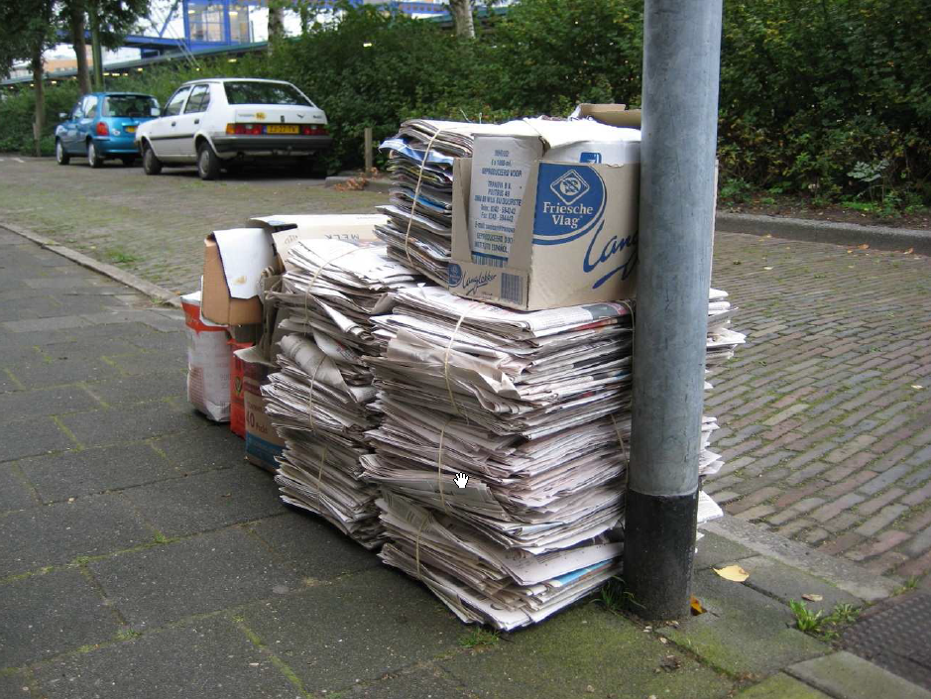
Documentation
Write once … and never look at after

Slide 3

Documentation
Usefull for users / Boring to write

Slide 4

Documentation
Hard to keep it up-to-dated

Slide 5
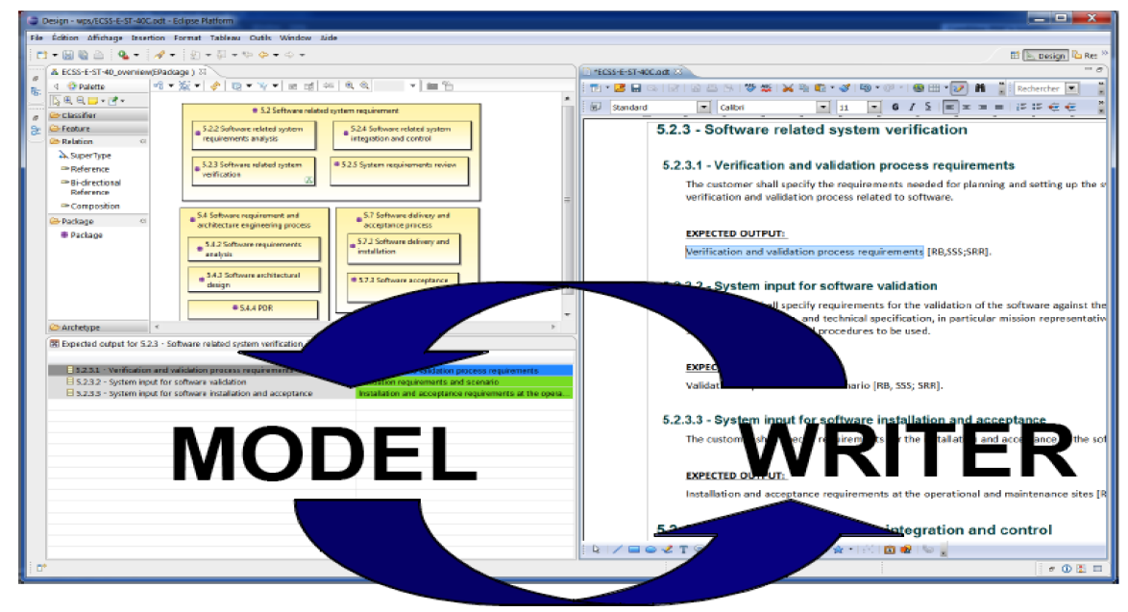

Slide 6
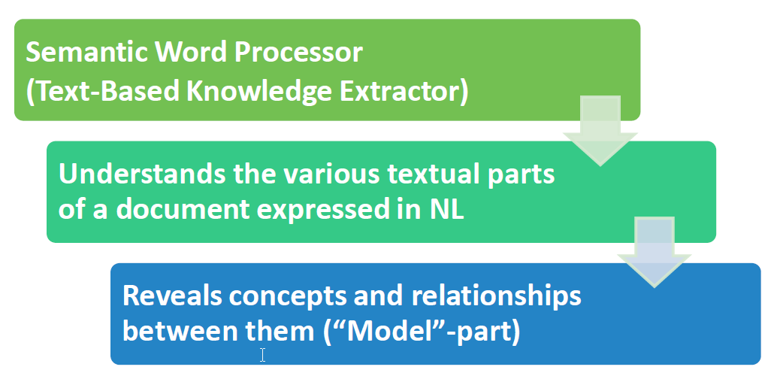

Slide 7
Use case

Slide 8

ModelWriter Architecture
Editor
Documents
(doc, docx, odt,textile,etc)
Texts
Connectors
Text
Semantic
Module
KB
Model
Models Connectors
Model Integration
Module
Model
Models
8

Slide 9
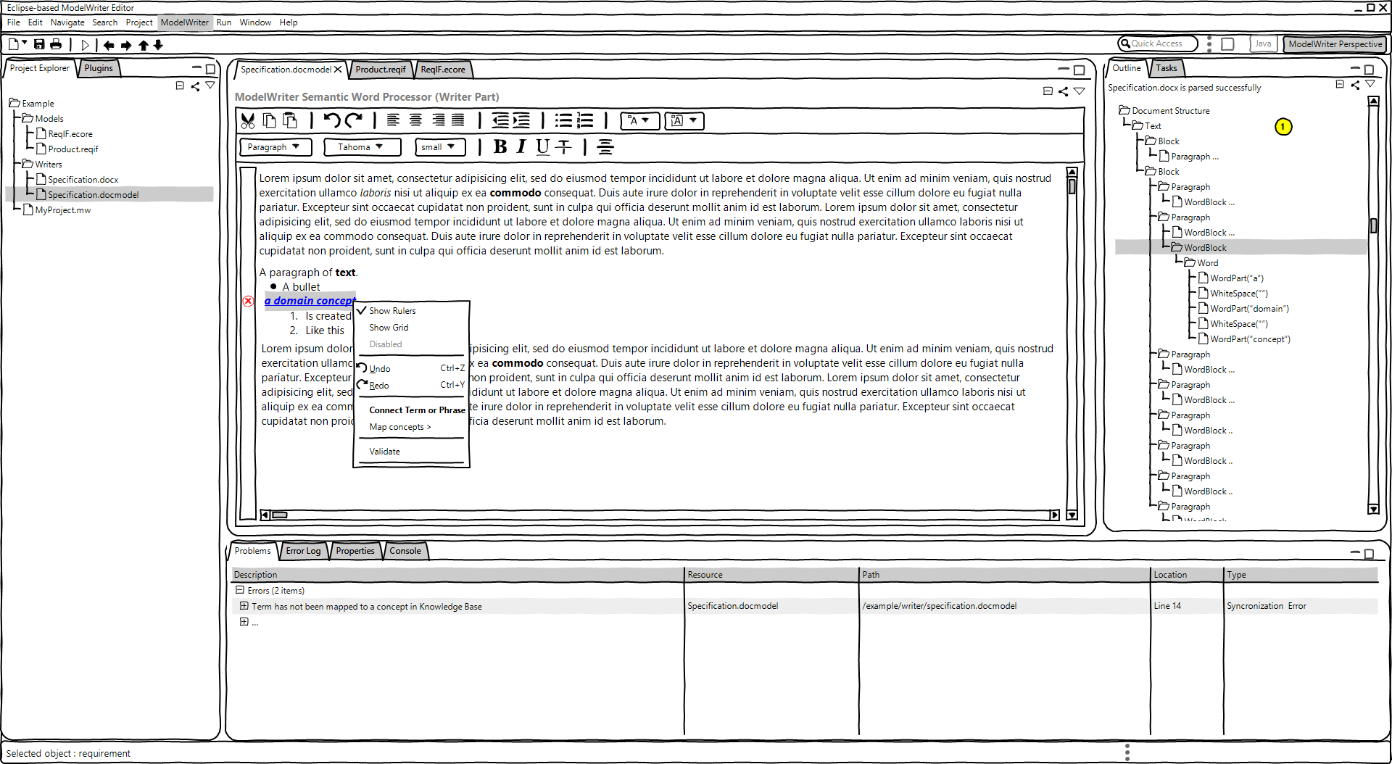
UI Sketcher

Slide 10
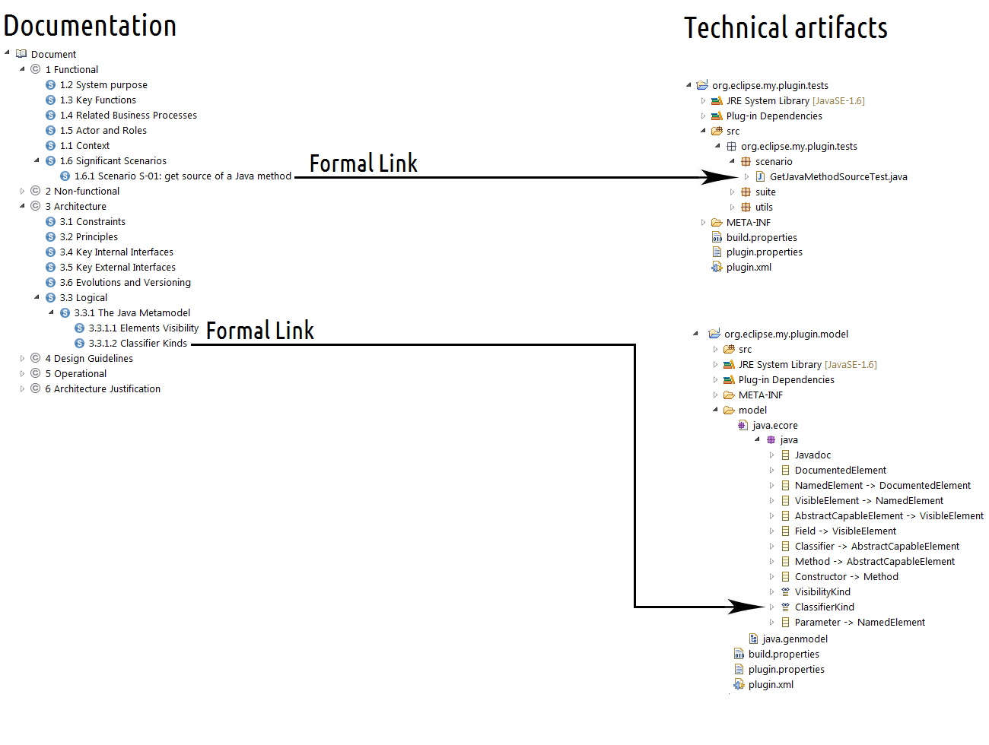

Mylyn Intent – Open Source project – Ex with Java
10
23/25

Slide 11
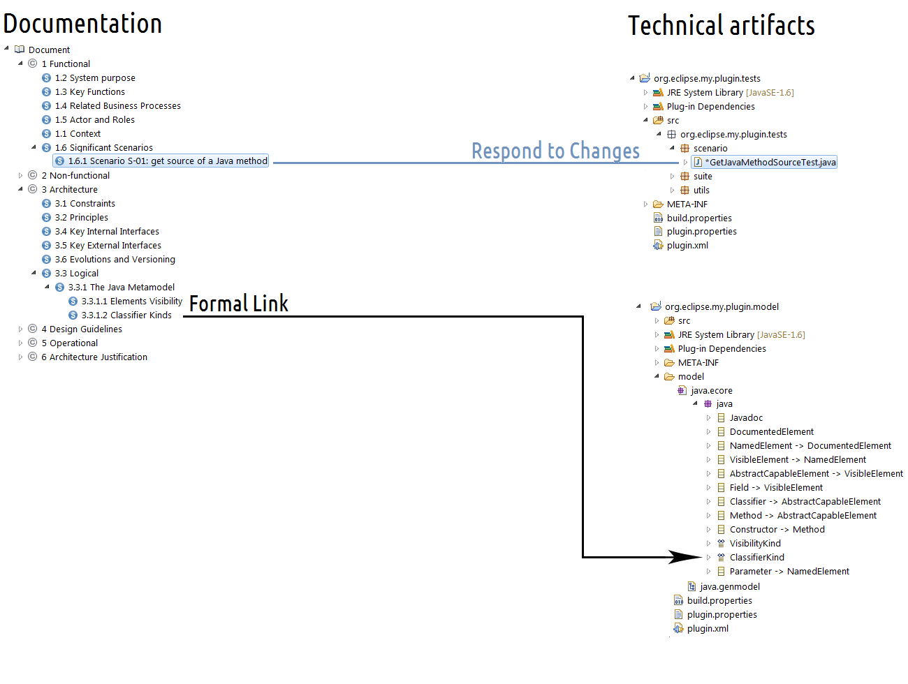
Mylyn Intent
11
24/25

Slide 12
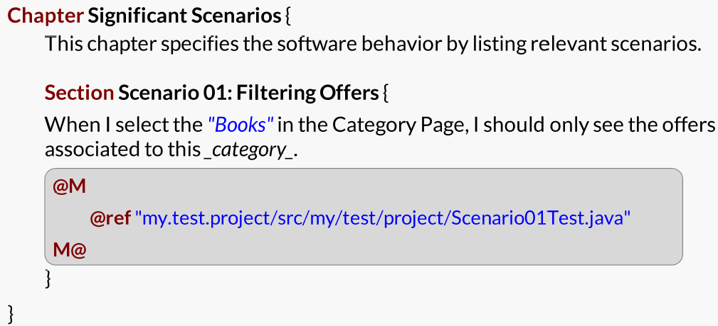
Mylyn Intent – 1st experimentation
Documentation zones
Model links zones
12
25/25

Slide 13

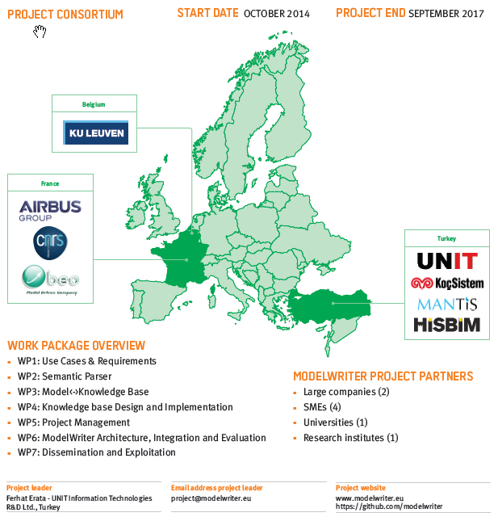

Slide 14
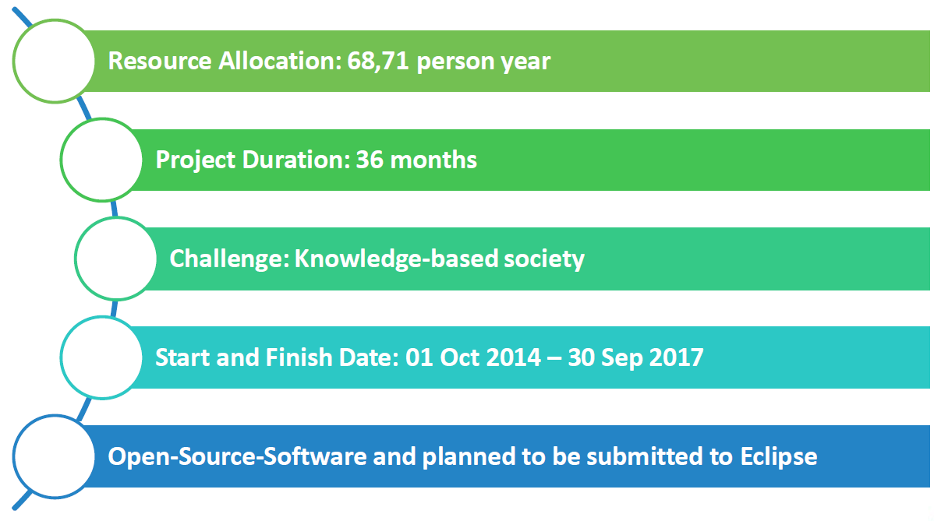
ModelWriter – overview and roadmap
14
25/25

Slide 15

Semantic Parser
Find semantic with ontologies

Slide 16

Semantic Parser
Keep the consistency across several vocabularies

Slide 17

Manage the (de)synchronization

Slide 18

Thank you

